Slide 1
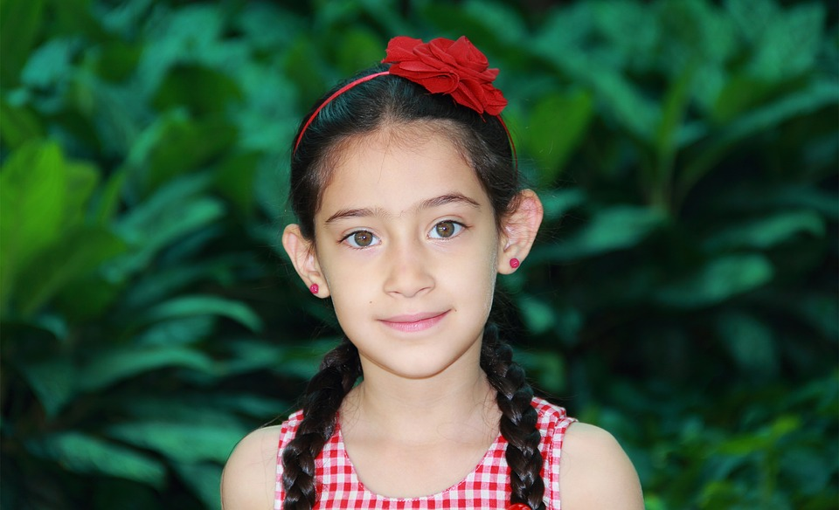
What does she look like?
She‘s a girl.
She‘s got long, straight, black hair.
She‘s got hazel eyes.
She‘s young, short and thin.

Slide 2
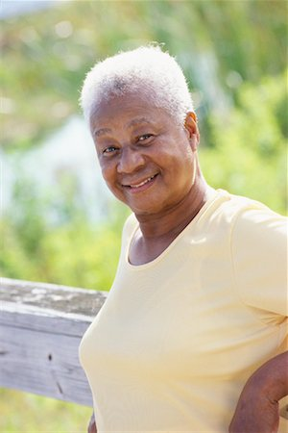
What does she look like?
She‘s a _______ (boy/girl).
She‘s got _______ (long/short) _______ (gray/black/brown…) hair.
She‘s got _______ (big/small) ________ (brown/hazel…) eyes.
She‘s _______ (old/young), _______ (fat/thin) and _______ (short/tall).

Slide 3
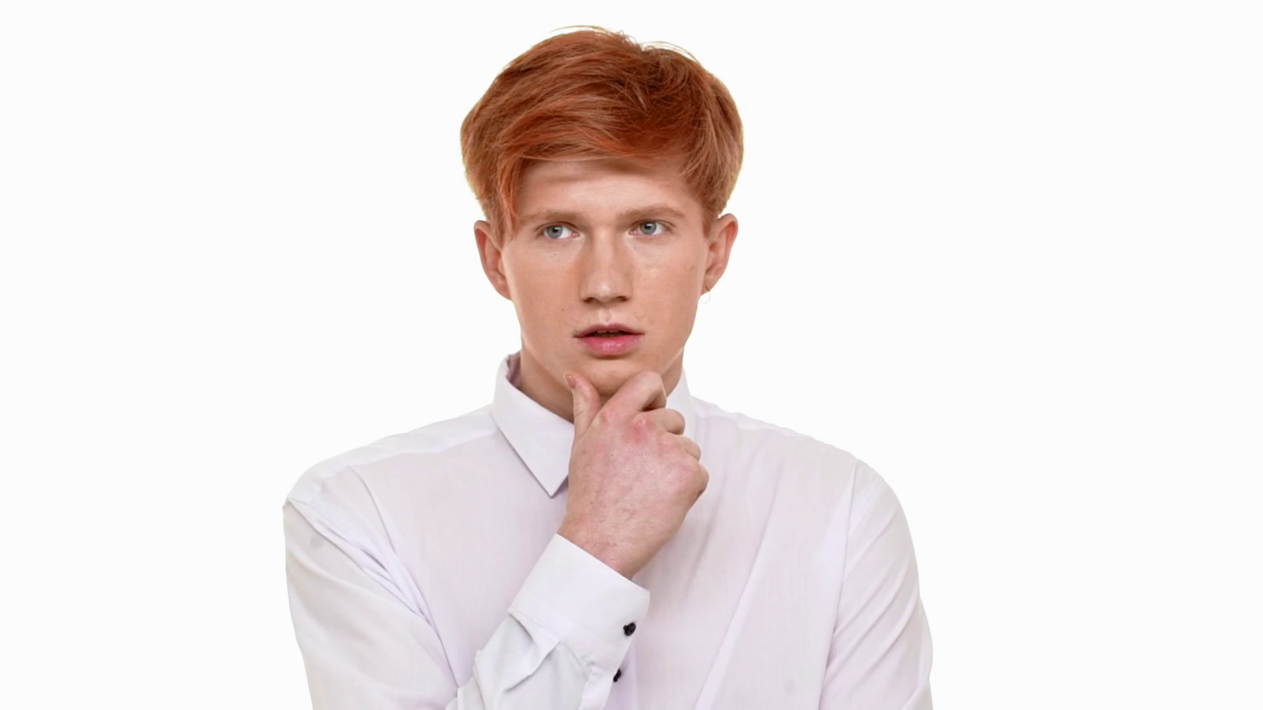
What does he look like?
He‘s a _______.
He‘s got _______ _______ hair.
He‘s got _______ _______ eyes.
He‘s _______, _______ and ______.
He‘s got a _________ mouth.

Slide 4
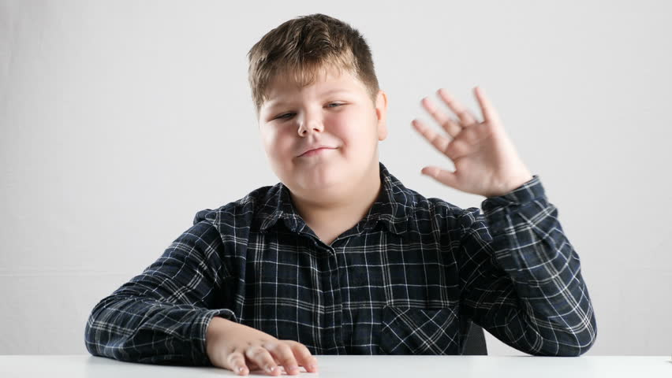
What does he look like?

