Slide 1
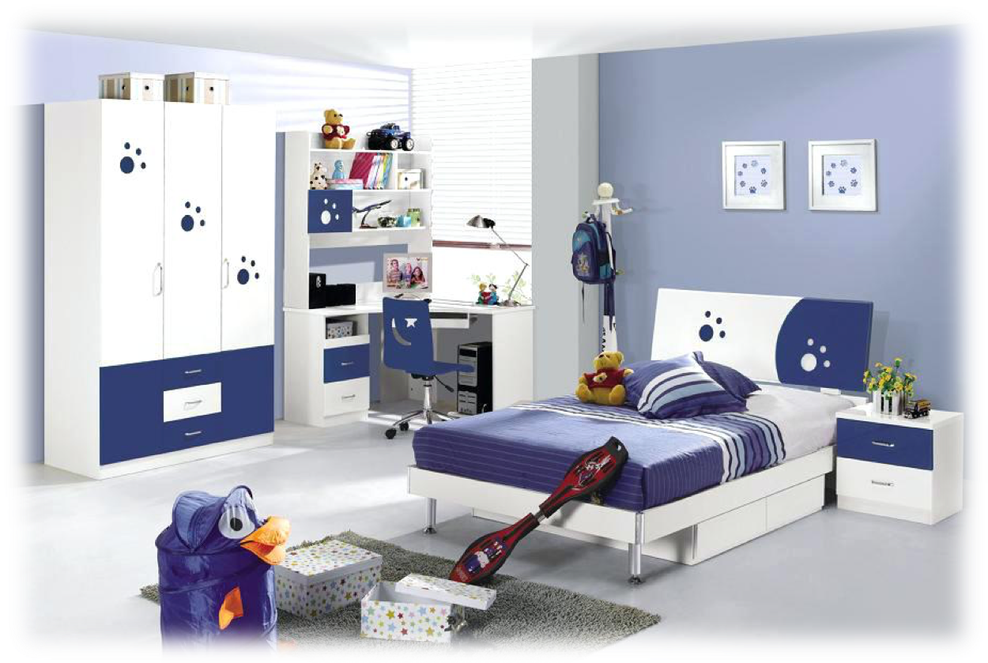
Where is the…..?

Slide 2
There is/There are
Ko opisujemo prostore v hiši in kje nek predmet stoji,
v angleščini uporabimo stavke there is /there are.
Če je predmet eden, uporabimo there is,
če je predmetov več, uporabimo there are.
Primeri: There is a fridge in the kitchen.
There are seven books in the bookcase.
1
2
3
1
2
3

Slide 3
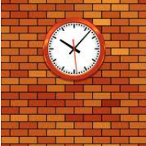
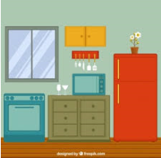
1. There is a clock on the wall.
Na steni je ura.
2. There is a fridge next to the cupboard.
Hladilnik je zraven omarice.
3. There is an oven under the window.
Pečica je pod oknom.
4. There is a TV between the fridge and the oven.
Televizija je med hladilnikom in pečico.

